Slide 1
Neural Networks &
Genetic Algorithms
Bujor Pavaloiu

Slide 2
Content (1)
1. Artificial Intelligence, Machine Learnig, Connectionist paradigm
2. McCulloch & Pitts neuron model. Perceptron
3. Adaptive Linear Neurons
4. Feed-Forward Neural Networks, Backpropagation
5. Deep Learning
6. Competitive learning Kohonen Self-Organizing Networks
7. Hopfield Networks
Neural Networks & Genetic Algorithms

Slide 3
Mc Culloch - Pitts Neuron Model (1)
Basic assumptions - Warren MuCulloch (neuroscientist) and Walter Pitts (logician) in 1943:
the activity of a neuron is an all-or-none (binary) process,
a certain number of synapses must be excited within a period of latent addition for a neuron to be excited,
the only significant delay within the nervous system is the synaptic delay,
the activity of an inhibitory synapse absolutely prevents excitation of a neuron,
the structure of the interconnection network does not change with time.
Neural Networks & Genetic Algorithms

Slide 4
Mc Culloch - Pitts Neuron Model (2)
The McCulloch-Pitts model was an extremely simple artificial neuron. The inputs is either a zero or a one.
One particular input can be an inhibitory one
If the sum of the inputs is more or equal than some threshold value T and inhibition is not present, then the output is zero. Otherwise, the output is one.
Simple update – create more inhibitory inputs. If an input is one, and is excitatory in nature, it added one. If it was one, and was inhibitory, it subtracted one from the sum. This is done for all inputs, and a final sum is calculated.
Neural Networks & Genetic Algorithms

Slide 5




Mc Culloch - Pitts Neuron Model
x₁
.
.
.
.
+
n
+
^{Τ}
x_{j}
Σ
y
.
.
.
.
.
-
x_{i}
Neural Networks & Genetic Algorithms

Slide 6
AND Logical Function
x₁
+
n
Σ
^{Τ=2}
y
+
x₂
No learning method for it
Neural Networks & Genetic Algorithms

Slide 7
Limitations
Boolean Inputs
Equal importance
Just one inhibitory neuron – solved easily
Arbitrarily setting of the threshold – no learning
Linearly separable problems
Neural Networks & Genetic Algorithms

Slide 8
Perceptron
Frank Rosenblatt, 1958.
The perceptron has weights associated to the inputs.
There exist a learning rule that converges to a solution if the solution does exist.
The solution is not unique
The perceptron can start with random values for the parameters.
Neural Networks & Genetic Algorithms

Slide 9
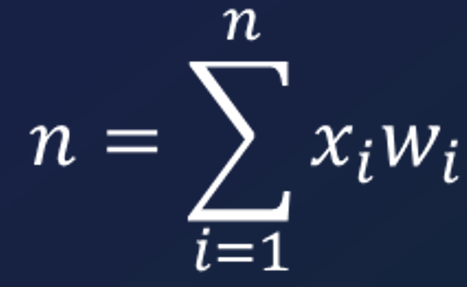
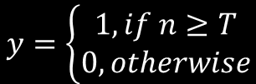
Perceptron
x₁
w₁
.
.
.
.
w_{i}
n
x_{i}
Σ
^{Τ}
y
.
.
.
.
.
w_{n}
x_{n}
Neural Networks & Genetic Algorithms

Slide 10



Perceptron
x₀=1
x₁
w₁
.
.
.
.
w₀=b
w_{j}
n
x_{j}
Σ
y
.
.
.
.
.
w_{n}
x_{n}
Neural Networks & Genetic Algorithms

Slide 11
Perceptron Learning Rule
Inputs are sets Xi and Ti
Initialize weights (including the bias)
Run through examples until all are matched
If error found e=T-Y=T-(WX>=0), update weights with dw=ex
Limitation – Linearly separable problems
Neural Networks & Genetic Algorithms

